Slide 1



Kaggle 5th Place Winning Solution SIIM-FISABIO-RSNA COVID-19 Detection
Team: Ayushman Nischay Shivam
Notes:
Recommending picking out he most interesting and important parts from your documentation.

Slide 2
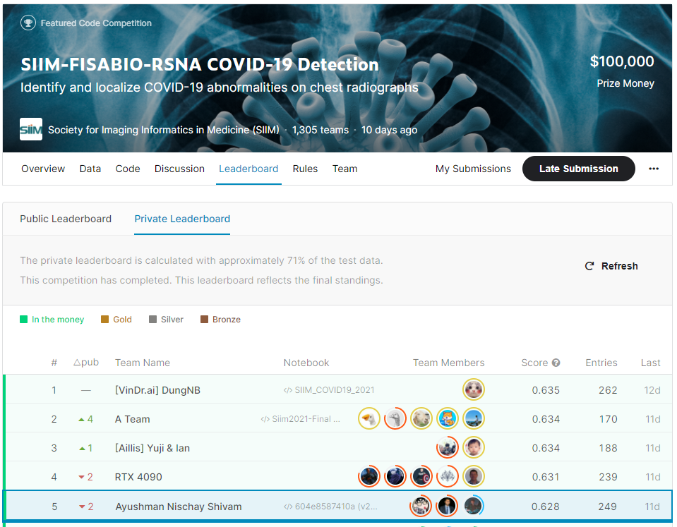
Team: Ayushman Nischay Shivam
Notes:
Recommending picking out he most interesting and important parts from your documentation.

Slide 3
Agenda

Slide 4
Agenda
Background
Summary
Preprocessing Methods
Training Methods
Important and Interesting Findings
Important Links

Slide 5
Background

Slide 6
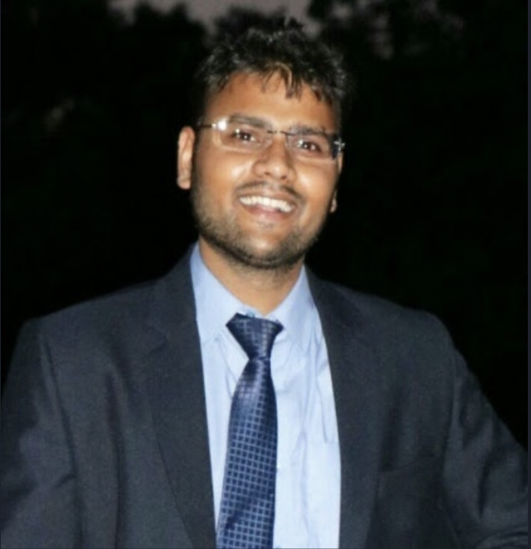




Background
Shivam Gupta
Data & Applied Scientist at Microsoft
Data Scientist at Huawei {2017-2019}
MTech in CSDP, IIT Kharagpur
M.Sc. in Mathematics & Scientific Computing, NIT Allahabad
A Kaggle Master (joined since 2018)
(2 Golds, 8 Slivers, 3 Bronzes, 21+ Competitions)

Slide 7
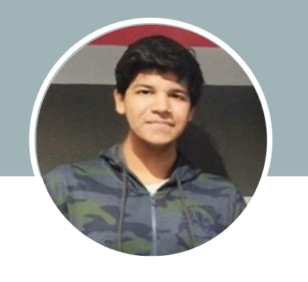

Background
Nischay Dhankhar
Undergraduate in Electronics and Communication Engineering
Pursuing B.Tech from NSUT, Delhi, India
Completed 5 ML/DL based MOOC and currently doing micro-masters in data science on online platform
Kaggle Competitions Master
Joined March 2020
(3 Gold, 12 Slivers & 4 Bronze medals, 42 competitions)

Slide 8
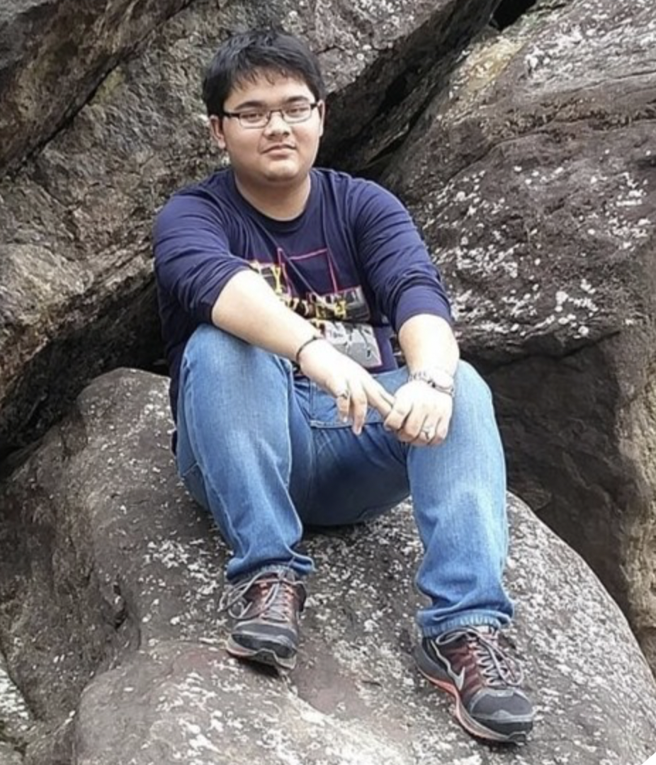
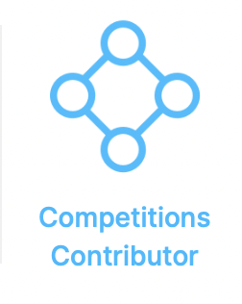

Background
Ayushman Buragohain
Undergraduate in Computer Science Engineering.
Pursuing B.Tech from Central Institute of Technology, Kokrajhar, India.
Student Intern at IIT Guwahati
Completed 5 ML/DL based MOOC

Slide 9
Summary

Slide 10
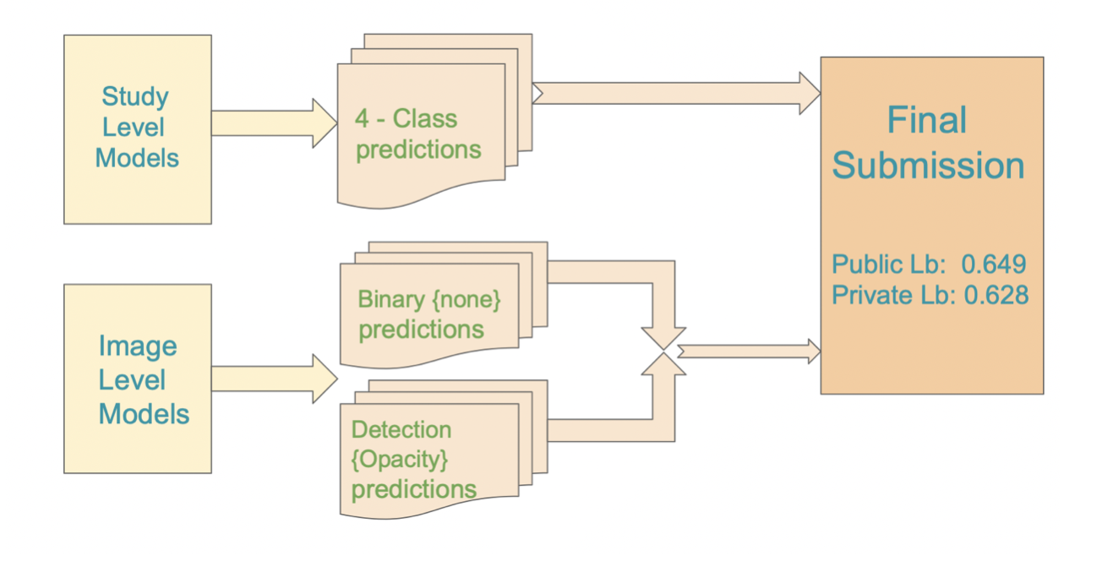
Summary
Our winning blend consists of :
16 multiclass classification models with 4 different architectures
2 x 5 folds (10) binary classification models with 2 different architectures
5 x 5 folds (25) object detection models with 5 different architectures

Slide 11
Preprocessing Methods

Slide 12
Preprocessing Methods
DICOM files to PNG images
Resize images to 1024 keeping aspect ratio same
Removing duplicates from data
Extracting masks using bbox labels
Group + Stratified K-Folds [5 folds]

Slide 13
Training Methods

Slide 14
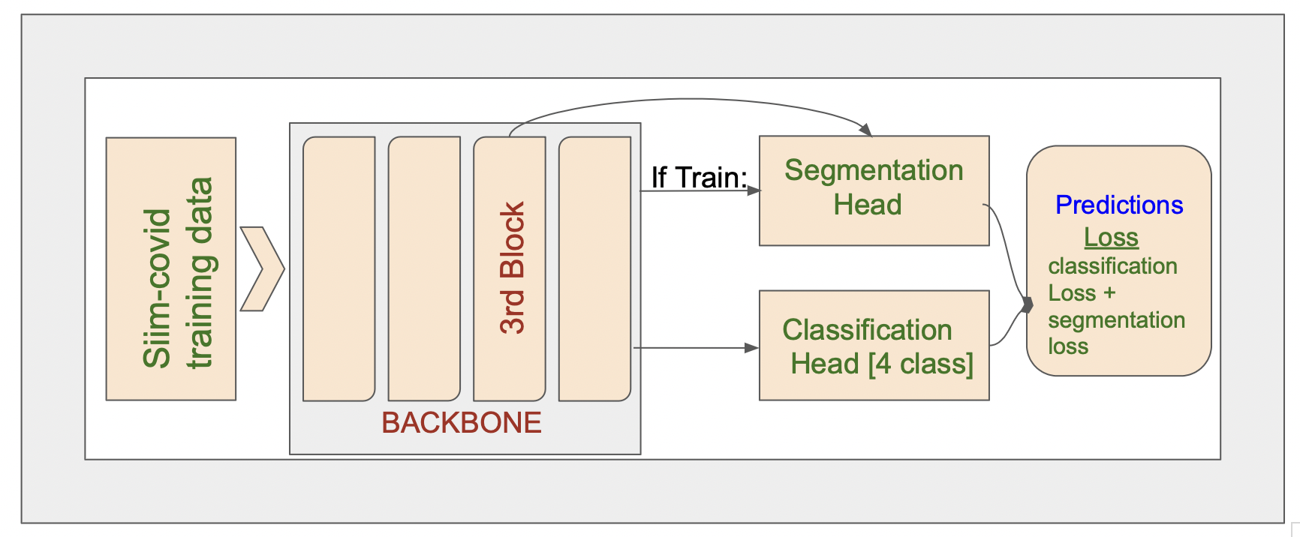
Training Methods
Study Level Models:
Baseline Architectures used in our final study level solution:
EfficientNet v2m
EfficientNet v2l
EfficientNet B5
EfficientNet B7
Things that worked for us:
Noisy Student training
Horizontal Flip Test Time Augmentation
Attention Head
Auxiliary Loss using Segmentation Masks
Kaggle Winner Presentation Template

Slide 15
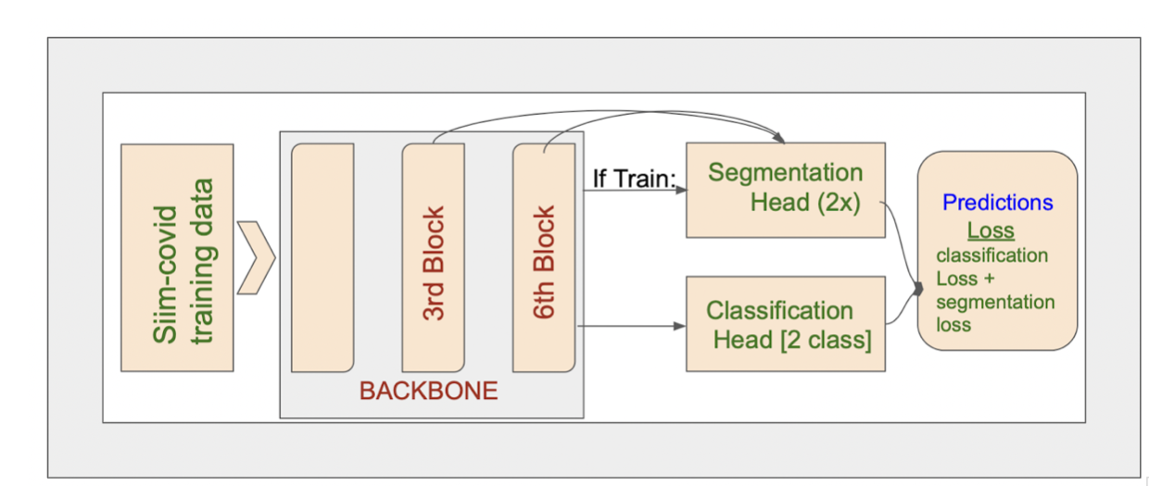
Training Methods
Image Level Models:
Baseline Architectures used in training Binary Classification Models:
EfficientNet B6
Things that worked for us:
Noisy Student training
Horizontal Flip Test Time Augmentation
Auxiliary Loss using Segmentation Masks
Kaggle Winner Presentation Template

Slide 16
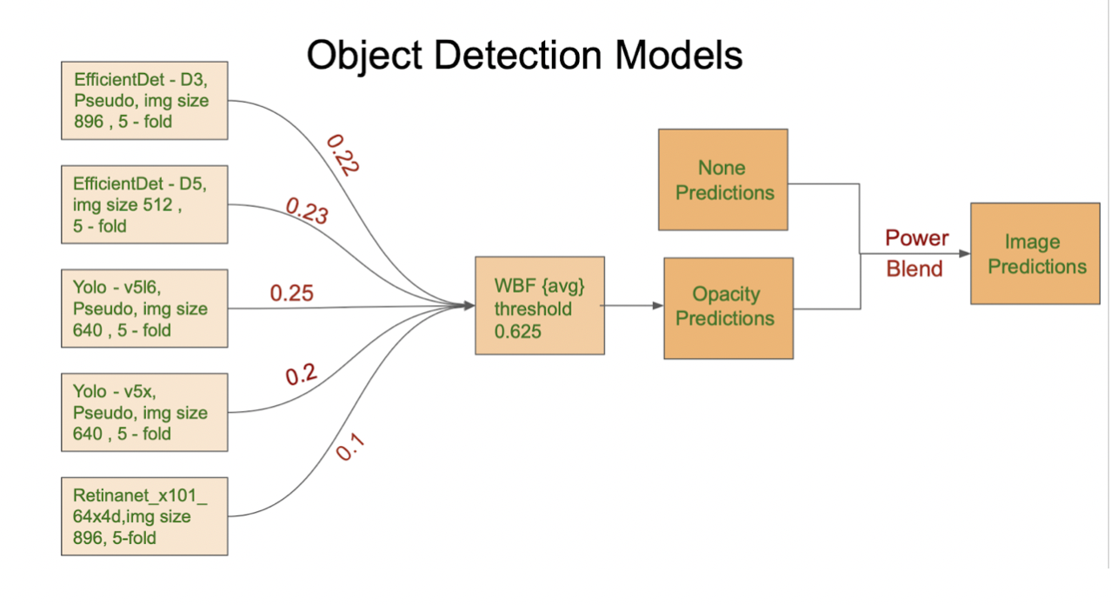
Training Methods
Image Level Models:
Baseline Architectures used in training Object Detection Models:
EfficientDet D3
EfficientDet D5
Yolo - v5l6
Yolo - v5x
Retinanet_x101_64x4D
Things that worked for us:
Pseudo Labelling
Ensemble
Kaggle Winner Presentation Template

Slide 17
Important and Interesting Findings

Slide 18
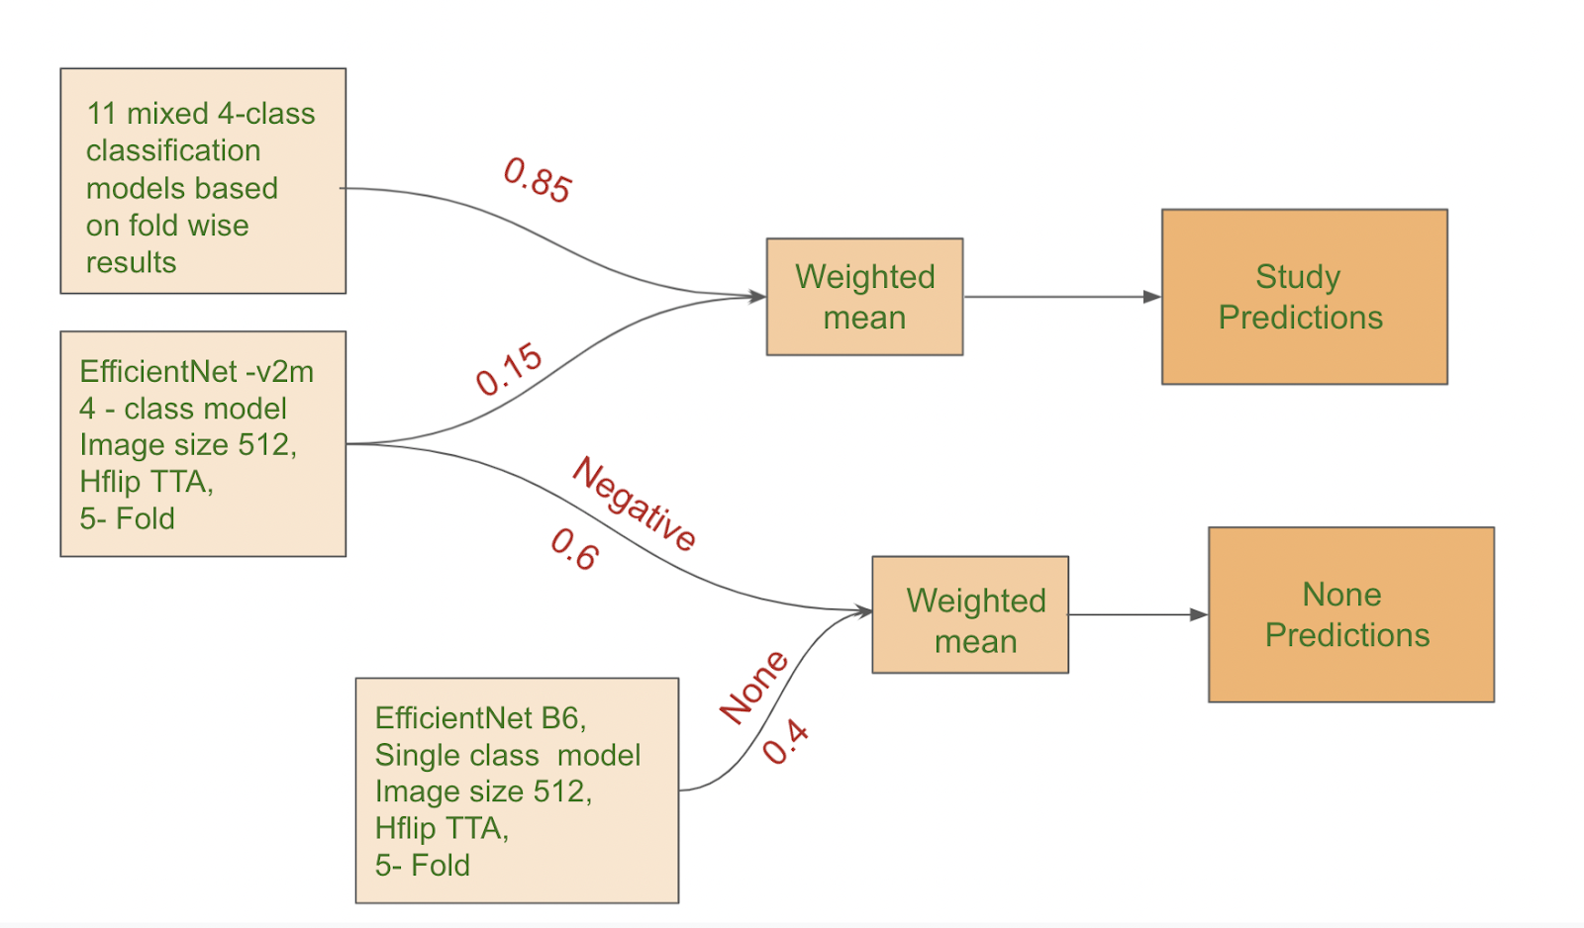
Important and Interesting Findings
Ensemble for Classification:
Kaggle Winner Presentation Template

Slide 19
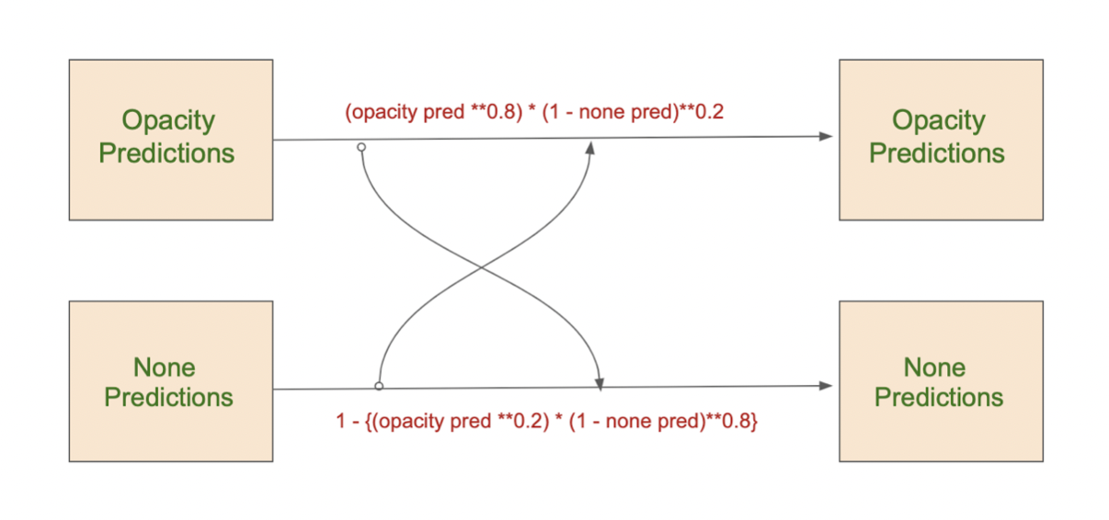
Important and Interesting Findings
Post Processing:
Kaggle Winner Presentation Template

Slide 20
Important Links

Slide 21
Important Links
Kaggle Competition Link:
https://www.kaggle.com/c/siim-covid19-detection
5th Place Posts Links:
https://www.kaggle.com/c/siim-covid19-detection/discussion/263680
https://www.kaggle.com/c/siim-covid19-detection/discussion/263945
https://www.kaggle.com/c/siim-covid19-detection/discussion/266571
5th Place Kaggle Inference Notebook:
https://www.kaggle.com/nischaydnk/604e8587410a-v2m-bin-weighted
5th Place Full Solution GitHub Repo Link:
https://github.com/benihime91/SIIM-COVID19-DETECTION-KAGGLE
Team Member’s Kaggle Profile Links:
Ayushman Buragohain: https://www.kaggle.com/benihime91
Nischay Dhankhar: https://www.kaggle.com/nischaydnk
Shivam Gupta: https://www.kaggle.com/shivamcyborg
Kaggle Winner Presentation Template

Slide 22


